Slide 1

ECB’s Monetary Policy Strategy Review: OOH and inflation measurement
ECB-UNRESTRICTED
ECB-CONFIDENTIAL
UN Network of Economic Statisticians
Sprint on OOH, 2nd meeting
20 September 2022
Stanimira Kosekova, ECB/DG-Statistics, with input from
E. Bobeica, M. Eiglsperger, B. Goldhammer (all ECB)

Slide 2
Motivation for looking at Owner Occupied Housing (OOH): 2021 Strategy review key topics
Inflation measurement
Price stability objective
Monetary policy instruments
Analytical framework
Monetary policy and financial stability
Climate change
Monetary policy communication
Digitalisation
Employment
Fiscal and monetary policy in a monetary union
Globalisation
Inflation expectations
Productivity, innovation and technological progress
Shadow banking
The ECB’s price stability concept
HICP potential measurement bias and measurement uncertainty
The role of OOH
Measuring the cost of living
The role of underlying inflation
Workstream publications: ECB Occasional Papers

Slide 3
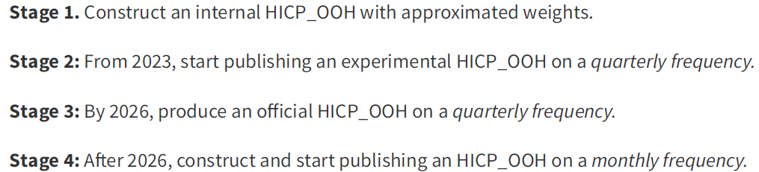
Motivation for looking at Owner Occupied Housing (OOH)
ECB-UNRESTRICTED
ECB Strategy Review, 2021
The HICP remains the appropriate index for quantifying the price stability objective
Inclusion of owner-occupied housing (OOH) costs in the HICP would improve the representativeness of the inflation rate, i.e. better scope by including also home owner occupiers, and would improve cross-country comparability
Changes in house prices considered important in context of overall inflation (e.g. in public "ECB Listens" events)
Roadmap proposed by the ECB’s Governing Council, while the competence of Eurostat and European National Statistical Institutes clearly acknowledged

Slide 4
Statistical challenges related to including OOH in HICP
ECB-UNRESTRICTED
The ECB’s Governing Council favours the net acquisition approach, as the closest one to fulfil the requirement of being based exclusively on actual monetary transactions
Reflecting house price developments in an inflation measure so that changes in house price pressures are signalled in a timely manner
… two types of challenges:
Conceptual
Consumption falls under the scope of the HICP, but not assets (e.g. related to land purchases, national accounts treatment of dwellings, consumption vs investment)
Practical – related to the feasibility of producing an index according to HICP standards of frequency and timeliness
The OOH price index (OOHPI) is currently compiled every quarter and released 100 days after the end of the reference quarter. To meet HICP requirements, the index would have to be produced every month, and released at the end of the reference month as a flash estimate and 15 days later with the full set of figures.

Slide 5
Economic analysis of OOH within the ECB
ECB-UNRESTRICTED
Monitoring
Data commentaries, assessment of latest developments in the documentation that goes to the Governing Council
Forecasting
Ongoing work together with the euro area National Central Banks (NCBs)
Research
Focus on the investment-consumption split of OOH
Looking at economic and statistical approaches

Slide 6
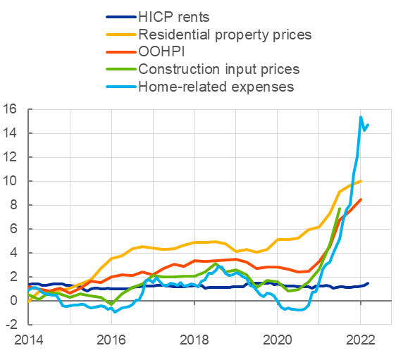
ECB-UNRESTRICTED
Monitoring euro area OOH
Euro area House Price Index and owner-occupied housing
(annual percentage changes)
House prices and OOH vs.
rents and home-related expenses
(annual percentage changes)
Source: Eurostat. Last observation: 2022 Q1.
Sources: Eurostat, ECB and ECB staff calculations. Latest observations: 2021Q3 for construction input prices, 2022Q1 for residential property prices and OOHPI and May 2022 for HICP rents.

Slide 7
ECB analytical combined HICP-OOHPI index: calculation steps
ECB-UNRESTRICTED
OOHPIs Quarterly Indices
Unchained growth rates
OOHPIs
and
HICP
HICP Quarterly Indices
Aggregation within and across countries for EA aggregate
Text here
Chain Linked indices creation
National Accounts:
GFCF in dwellings
Weighted by EU-SILC ownership rates
Scaled up using the within OOHPI item weights
Main part
National Account:
HH Final Consumption
Price updating of the Weights

Slide 8
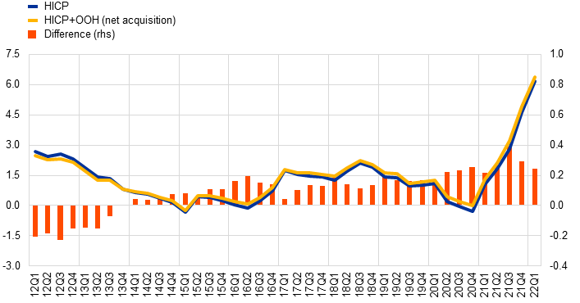
ECB-UNRESTRICTED
ECB analytical combined HICP-OOHPI index: results
Index using the net acquisition approach to OOH
(left-hand scale: annual percentage changes; right-hand scale: percentage point differences)
The euro area HICP combined with the OOHPI show inflation rates that do not differ greatly from those of the HICP without OOH-related costs
Largest estimated difference vis-à-vis HICP over the period 2011-2021: 0.4 p.p.
The combined index with net acquisition OOHPIs amplifies the cyclicality of inflation
Source: ECB Economic Bulletin, Issue 1/2022, Article entitled “Owner-occupied housing and inflation measurement”, by Martin Eiglsperger, Rodolfo Arioli, Bernhard Goldhammer, Eduardo Gonçalves and Omiros Kouvavas Note: Eurostat and ECB staff calculations; last observation: 2022 Q1

Slide 9
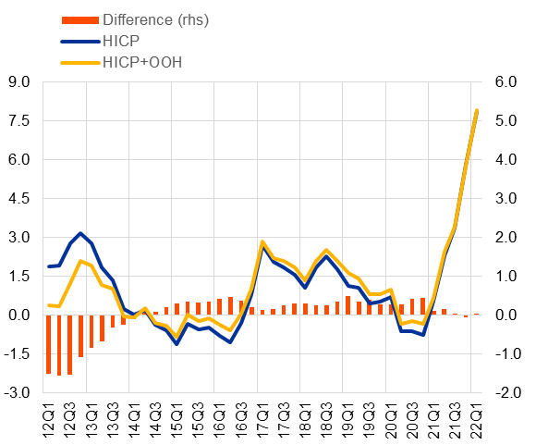
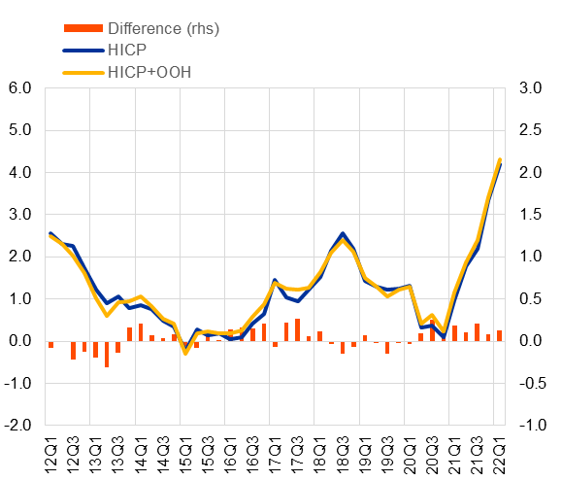
ECB-UNRESTRICTED
HICP-OOHPI index: Heterogeneity across Member States
HICP and HICP+OOH
(annual percentage changes and percentage point differences)
Spain
France
Source: Eurostat and ECB calculations.
Note: Unpublished data
9

Slide 10
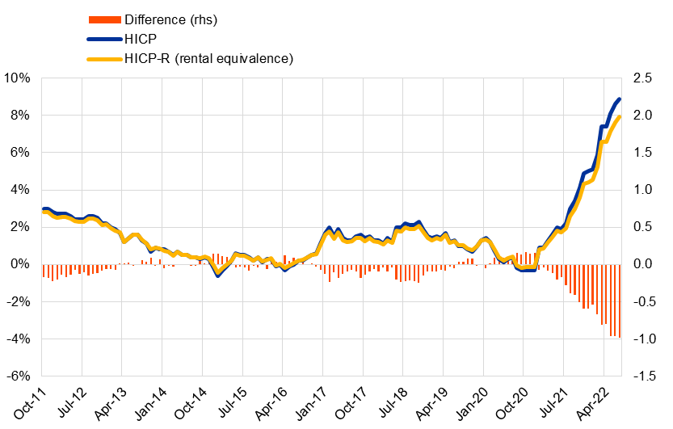
ECB-UNRESTRICTED
HICP and OOH using rental equivalence
Index using the rental equivalence approach to OOH
(left-hand scale: annual percentage changes; right-hand scale: percentage point differences)
HICP-R calculated as monthly price index; simplified approach (using imputed rents from national accounts as weights; but HICP rents price index)
The euro area HICP combined with the imputed rents for OOH show inflation rates that do not differ greatly from those of the HICP without OOH-related costs in the periods of low inflation
Amplified differences since mid-2021
Largest estimated difference vis-à-vis HICP over the period Oct2011-Mar2022: 0.9 p.p.
Source: ECB Economic Bulletin, Issue 1/2022, Article entitled “Owner-occupied housing and inflation measurement”, by Martin Eiglsperger, Rodolfo Arioli, Bernhard Goldhammer, Eduardo Gonçalves and Omiros Kouvavas Note: Eurostat and ECB staff calculations; last observation: July 2022

Slide 11
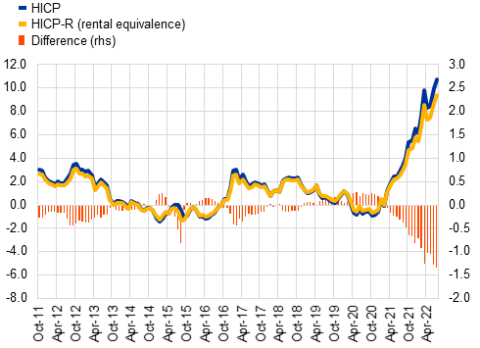
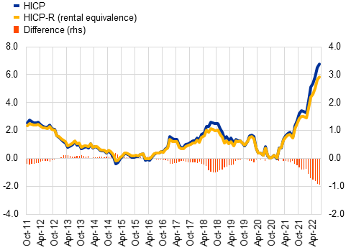
ECB-UNRESTRICTED
HICP and OOH using rental equivalence: Heterogeneity across Member States
HICP and HICP-R
(annual percentage changes and percentage point differences)
Spain
France
Source: Eurostat and ECB calculations.
Note: Unpublished data
11

Slide 12
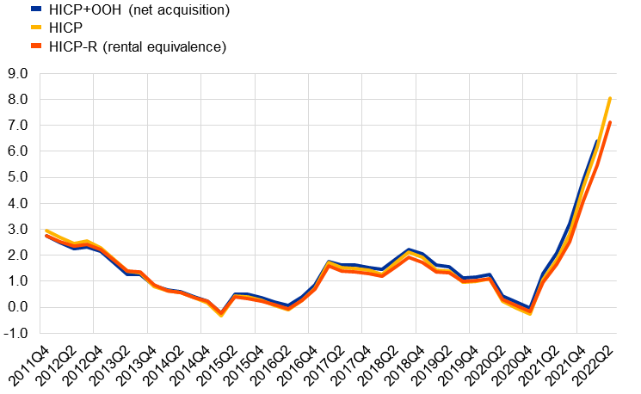
ECB-UNRESTRICTED
Estimated impact of including OOH in HICP
Net acquisition vs Rental equivalence approaches
(left-hand scale: annual percentage changes; right-hand scale: percentage point differences)
Source: Eurostat and ECB staff calculations; last observation: June 2022 for HICP and HICP-R; 2022 Q1 for HICP+OOH Notes: for the Table: calculations refer to 2011 Q4 – 2022 Q1 (values in backets include 2022 Q2).

Slide 13

ECB-UNRESTRICTED

